Slide 1


Cultivating Resilience for Global Workers through Sacred Rhythms and Soul Care

Slide 2
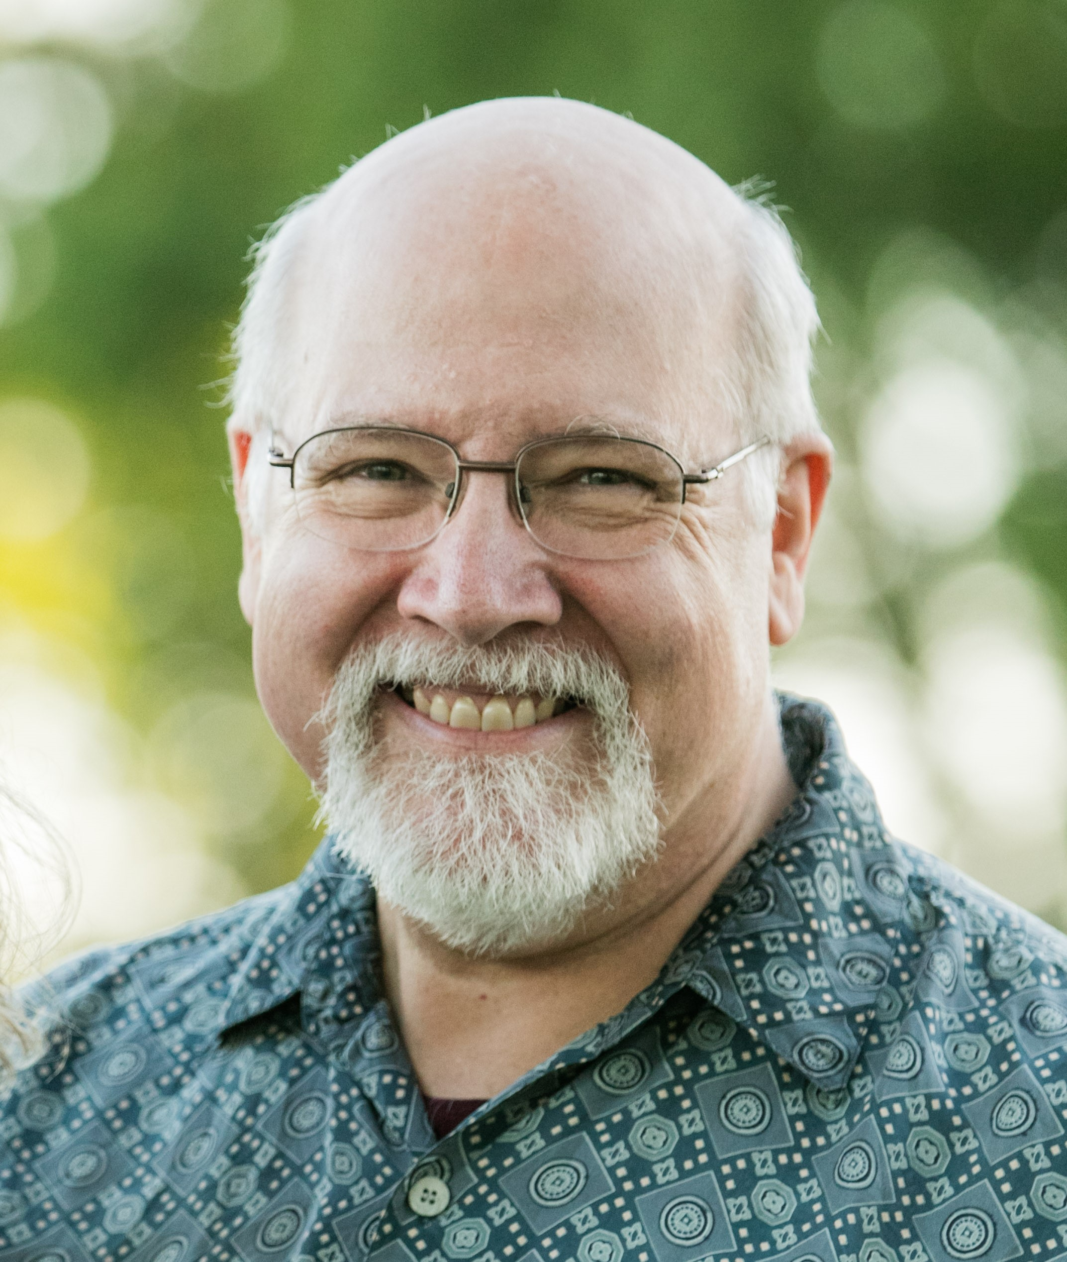
Rev. Dr. Herb Lamp
Over 40 years in ministry as a global worker
Served in Serbia, Austria, and Germany from 1981-2008
Since 2009, serving with Barnabas International in pastoral care

Slide 3

Soul Care Sacred Rhythms Hindrances Spiritual Practices Encouragement

Slide 4

Soul Care
“. . . let us run with endurance the race that is set before us, fixing our eyes on Jesus, the author and perfecter of our faith . . .”
Hebrews 12:1-2
Notes:
What is soul care and why do we need it? (Discuss in groups of three to five)
Soul care is a means of restoring brokenness between me and God, me and self, and me and others, and me and my environment (creation). How does soul care bring me into restoration with God, self, others and creation?
Soul care helps you live from a healthy soul and wisely you to authentic transformation into the character or likeness of Jesus Christ.

Slide 5

Running with Endurance
“If I was asked how to stay on the field long-term today, I would say that neither outward strength nor inward conviction is the key to longevity. Rather, cultivating God’s loving presence is the mark of perseverance and endurance – the key to longevity.”
Journey With Me
Notes:
Several years ago, I started to see a trend with so many of the guys I was talking to concerning their walk with the LORD and their life and ministry. They would come to me complaining and wondering if what they were experiencing as all there was to the Christian life. Most had been in ministry for quite a while and had served faithfully for many years on the field and yet, they while not necessarily burned out, they were struggling in feeling any joy and intimacy with Christ. As I began to explore reasons for this, it soon become apparent that almost to a person they were experiencing a lot of activity and performance-based Christianity and ministry, vey little resting in their identity with Christ. They had placed their call to the field and ministry ahead of their relationship with God. So, for example, their time in the Word weas simply time spent preparing for their next Bible study or their next sermon or their next whatever, hardly ever were they just spending time simply being with God trough His word. As we talked, they soon realized this fact, but they seemed to be helpless in changing – they did not know to grow in intimacy with the Father.
This I am sure is not an unique experience with me, but probably each of you who have walked with others have walked with others have also to some degree seen this in their lives as well. It was for this reason that I wrote JWM. To help global workers develop their spiritual lives by examining both hindrances as well as pathways through those hindrances to full abundant life with Christ.
Each chapter in the book explores an ancient pathway of spiritual growth and transformation and particular fruit of such spiritual graces. So, for example there is a chapter exploring how a global worker may practice Sabbath-keeping and the God-given fruit of Rest that comes out of such practice. Or, how practicing hospitality can lead one toward realizing the gift of space and freedom it brings.
I have 18 such spiritual practices in the book, and none are unique to me. They are time-tested and biblically affirmed spiritual ancient pathways of growth in the Lord that have been part of the church’s teaching for centuries. However, what might be unique is the background discussion of these ancient pathways within a global mission context.
So how might you use this material with the global workers you shepherd? First, let them read the context. At the end of each chapter is a series of reflection questions as well as additional resources to help them both grapple with where they are in this particular spiritual disciplines as well as give them further areas of study if they want to go deeper on the subject. Then in various formats such blogs, podcasts, email, articles, personal visits or coaching sessions you can explore where they think there are and how they want to grow in these areas. But I need to remind us that our relationship with the LORD is not about performance – doing these practices does not necessarily increase our love, dependence or growth in the LORD. It is always a heart-matter and dependent on the Holy Spirit to produce the fruit in our lives. But in less we start with our heart – our hands of ministry will just lead us to being jaded, cynical and burned out for the ord. If you are seeing that among you people consider introducing them under the guidance of the Spirit’s overflow into their lives these practices.

Slide 6

“Stand at the crossroads and look; ask for the ancient paths, ask where the good way is, and walk in it, and you will find rest for your souls.” Jeremiah 6:16
Notes:
Jeremiah points us back to the ancient pathways of spiritual transformation which for him was to practice what Moses in his last sermon proclaimed in Deuteronomy 6 “This is the commandment, the rules and regulations, that God, your God, commanded me to teach you to live out in the land you’re about to cross into to possess. This is so that you’ll live in deep reverence before God lifelong, observing all his rules and regulations that I’m commanding you, you and your children and your grandchildren, living godly long lives. Listen obediently, Israel,. Do what you are told so that you will have a good life.”
Soul care simply points us back to God to deepen and transform us so that we will have a good life. Not necessarily an easy life, but a good one.

Slide 7
Soul Care means:
Physical Self-Care – taking steps on behalf of our bodies
Mental Self-Care – being intentional about what we put into our minds
Emotional Self-Care – being authentic and honest about our emotions
Relational Self-Care – Cultivating reciprocal relationships in which we are equally attended to, sought out, cared for, and nurtured
Spiritual Self-Care – Staying in a place of humility and grace, awestruck by the privilege of being a servant of the living God
Notes:
Here is what soul care means in a practical, comprehensive way.

Slide 8

What happens when we do not attend to our Souls?
“The failure of leaders to deal with their own souls, their inner life, is deeply troubling not only to their selves but also for other persons in the ministry they cause. The destructive consequences from leaders who fail to work out of a deep sense of inner sense are staggering.”
Patricia Brown, Learning to Lead from Your Spiritual Center
Notes:
What are some of the destruction that happens in our relationships – to God, ourself, others and our world when we do not attend to our souls? (Discuss in groups of 3-5)
John Calvin is famous for starting his Institutes, his great theological work by declaring that knowledge of God is tied up to knowledge of ourselves. He writes: Nearly all wisdom we possess, that is to say, true wisdom and sound wisdom consists of two parts: the knowledge of God and the knowledge of ourselves.”
If we do not understand ourselves – our weaknesses, our triggers, our limitations, our capacities, our strengths, we are prone to harm not only ourselves but others. We need constantly to be asking ourselves questions like: Where am I right now? What are my feelings, thoughts, joy, longoings,? How do I view myself in regard to where I am right now in life and ministry? Do I feel burned out or overwhelmed? What temptations am I facing? Where is the good getting in the way of the God’s purposes for me?
And we need to be asking the questions concerning our relationship to God: How are you experiencing Him right now? What is He speaking to you in your heart?
So how do we best do this? We do this by practicing sacred rythyms.

Slide 9

Sacred Rhythms
Rhythm: a strong, regular, repeated pattern
Sacred: connected with God, dedicated to God
Personal
Flexible
Balanced
Notes:
To practice sacred rhythms is a commitment on our part to life our life in an intentional and certain way. It moves us toward better congruence between our intentions, thoughts, words, and behaviors. It is intended to help us attain and maintain structure to facilitate our whole lives: physical, relational, psychological, and spiritual. However, there is not one pattern for everyone. My rhythm is going to look different from yours because I am different from you. So our rhythm should be personal – tailored to me, flexible, relating to my schedule and season in life, and balanced taking in all parts of my soul – physical, mental, emotional, and spiritual.

Slide 10

Daily, Weekly, Monthly, Annual Rhythms
“Write these commandments that I’ve given you today on your hearts. Get then inside of you and then get them inside your children. Talk about them wherever you are, sitting at home or walking the street; talk about them from he time you get up in the morning to when you fall into bed at home.” Deuteronomy 6:6-8,The Message
“Take your everyday, ordinary life – your sleeping, eating, going-to-work, and walking-around life – and place it before God as an offering. Embracing what God does for you is the best thing you can do for him. Don’t become so well-adjusted to your culture that you fit into it without even thinking. Instead, fix your attention on God. You’ll be changed from the inside out.” Romans 12:1-2, The Message
Notes:
Read the scriptures.
God’s Word tells us that our ordinary life should be the stuff of the sacred. Yet as we mature in the Lord, we will see that our rhythms can shape us in daily practices, weekly practices, monthly practices, and yearly practices. How might we practice a daily rhythm? (daily devotions); weekly (observing the Lord’s Day); monthly (spiritual conversation with a friend); annual (retreat).

Slide 11

Why are rhythms important?
Our lives depend upon rhythms
Jesus modeled rhythms
Rhythms mediate grace
Rhythms help discern God’s voice
Notes:
We are created to follow the rhythms of life. We awake in the daylight hours, we sleep in the night hours. We work six days, we rest one day. We see the seasons of weather and adjust to each accordingly. God made us so we naturally fit into rhythms. And if you read the Gospels, you see Jesus likewise followed rhythms. He often withdraw to lonely places after intense ministry. He followed the cycle of rest and work. He practiced the great religious holidays of his culture. He celebrated the Passover with his friends. He practiced sacred rhythms.
Paul tells us to be filled with the Spirit in Eph 5:18. But dos that take place? Might I suggest it happens in a two-stage approach. Let me illustrate what I mean:
Take a glass of water – it is already full of things – maybe some liquid, maybe dirt, maybe some water? And I tell you to fill it with clean water – can you do so – not without a lot of spillage and mess.
But if I tell you to first empty the glass and then fill it – you can do it well.
Being filled with the spirit requires us to empty ourselves first. To release the cares and problems., the sins and worries that encompass us and then to invite the Holy Spirit into those places to fill us with His presence. Now, both oarts are acts of God. We really cannot empty ourselves anymore that we can fill ourselves. But, what scared rhythms do is to be a tool to be used of God to help us in both emptying and filling. That is why rhythms mediate grace. And in douing so, we are so much able to discern God’s invitations to us as well.

Slide 12

Life is so busy
Life is so stressful
Life is so burdensome
Life is not often restful
Life is so expensive
Life is confusing
Notes:
What are some things which might get in the way of practicing soul care by global workers? (Discuss in groups of 3-5) – list on SNOW?

Slide 13
Hindrances
Life is so busy
Life is so stressful
Life is so burdensome
Life is not often restful
Life is so expensive
Life is confusing
Notes:
Discuss SNOW?

Slide 14
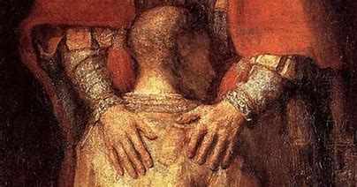
“The Fact is that there is nothing we are doing that God could not raise up a stone in the field to do for Him. The realization of this puts us in our true place. Though, lest we get knocked down by such a realization of our insignificance, let me hasten to add that there is one thing alone we can give Him . . . and that is our personal love. No one else can give God our personal love. That is our great significance.” Basil Pennington
Notes:
Bottom-line truth – No one is indispensable to the Kingdom – but if we are not careful, we might short cut through exhaustion, depression, barrenness and burnout all that God wants to do through us. Ultimately, all we can give God is ourselves. And ultimately, that is all God wants as well.

Slide 15

Three Important Things to Give our Missionaries
1) Permission to craft their lives around sacred rhythms
2) Tools to support them
3) Encouragement to live into a lifestyle of sacred rhythms
Notes:
First, give permission. It is vitally important for missionaries to feel we are okay with them focusing in on their soul care. As strange as it may sound, they sometimes need permission to take care of themselves. Why might this be?
(Supported missionaries feel the pressure to justify their donor’s gifts).
If we tell them, it is not selfish to take care of their souls and we trust them in this process it can free them up to do so.
Second, help them find tools to tend their souls and bodies. We might need to teach on the subject. Brings helps to them. Such as? (good books, apps, seminars, articles, podcasts) (provide financial resources for them to go on a retreat, or a conference, encourage a sabbatical, and yes even to help them go on a vacation!)
And finally, follow-up and encourage them. One way to do this is to ask them their state of their soul. Ask them do they feel they have sufficient spiritual rhythms in their lives? What robs them of time with God? How deos technology impact your soul? What is restful for you? Refreshing? Do so, however, in a safe and caring way. They must not feel judgment or evaluation is part of the process. Maybe send a pastoral couple to the field to ask and support them in soul care.

Slide 16
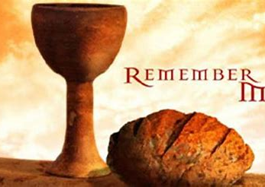
What is a spiritual practice?
Acts 2:42
“They devoted themselves to the apostle’s teaching (a practice) and to the fellowship (relationships), to the breaking of bread (an experience) and to prayer (another practice).”
The desire to know and love God fueled these practices.
Notes:
Now, one of the ways we can help teach soul car for our workers is to expose them to spiritual practices. A spiritual practice is anything that can unite our discipline and desire for godly living into the transformation our souls into the image of Christ. In theological terms we call this sanctification, and it is exclusively the work of the Holy Spirit.
Spiritual practices don’t give us “spiritual brownie points” or help us achieve spiritual greatness. What they do is simply put us in a place where we can begin to notice God and respond to his invitations to us. Spiritual practices open up space for us to see and to hear God in our lives. As the Holy Spirit leads us, he knows what spiritual practices best suit our current and unique communication with God. So, as we said before our practices are best when they are personal, flexible, and balanced.

Slide 17
Notes:
Now, we d need to make sure it is rooted in scripture and traditions of the church. What are the eseentials spiritual practices that should be characterize the state of every Christian’s walk of faith? There are three.

Slide 18

Tools: Spiritual Practices
The three great Spiritual Practices of the Church:
Scripture
Prayer
Reflection
Notes:
The Word is the center of our life before God. Pray is also essential for soul care. But I also believe that a reflective life is necessary. We evangelicals are great at staying in the Word. We are okay at prayer. But we (and especially us Americans) are simply terrible at reflection. We are not a reflective culture. But to gain wisdom and soul substance, reflection is absolutely essential. We do not learn if we do not reflect. And so many of us need to be taught how to reflect well.

Slide 19

Spiritual Practices
Notes:
Let us list some spiritual practices (disciplines) or as America’s greatest theologian Jonathan Edwards called them spiritual graces. What are some: Prayer (centering prayer, breathe prayer, prayer of examen, contemplative prayer, intercessory prayer, confessional prayer, fixed hour prayer, conversational prayer)
The Word (Bible study, reading, lectio, meditation, memorization)
Reflection (journaling, examen, retreating, Sabbath-keeping)
Silence and Solitude
Fasting
Slowing
Unpluggng
Rule of Life
Rest
Submission
Truth telling
Hospitality
Gratitude
Humility
Practicing the Presence
Life-long learning
Spiritual Direction
Adele Calhoun lists 62 spiritual practices in her book: Spiritual Disciplines Handbook
In my book, Journey with Me I list 19 practices as it relates to missionaries.
And there are many, many more – because we can tailor practices to our own lifestyle and relationship to God. For example, can daily walks be a spiritual discipline? Weekly spiritual conversation with a close friend? Even taking a daily nap? Yes, depending on how it it practiced – all can be a practice that you put into your life rhythm.

Slide 20
Encouragement
Communicate: How is it going?”
Offer to help
Explore with them stages of spiritual growth
Encourage spiritual retreats
Notes:
My life has been shaped by men and women who have loved me and handed me something of God in their very human lives. Their spiritual practices were woven into the fabric of their lives on the loom of relationships with God and with me. They were not perfect but even in their stumbling and bumbling ways, they set an example for me to follow.
Disciplines are to be learned and we learn them best in relationships. So, after you give worlkers permission to tend to their souls, and after you help them discover tools that work for them, finally bring encouragement to thei hearts. God can use you in the power of the Holy Spirit to simply be there for them. Her are fours suggestion in order to encourage your worker.

Slide 21

Sacred Rhythms
“I cannot transform myself. . . What I can do is create the conditions in which spiritual transformation can take place, by developing and maintaining a rhythm of spiritual practices that keeps me open and available to God.”
Ruth Haley Barton, Sacred Rhythms
Notes:
Like the four seasons of our life, spiritual transformation follows the movement of God’s Holy transforming power through stages and experiences. We need to encourage our people to not give up or give in to the temptations of overwork and under dependency upon the Lord. Sacred rhythms can produce a richness in life that moves us through all its seasons. Each ends not by our own doing. Our responsibility is simply to know the season and match our actions and inactions to it. Yes, it can be the slow hard discipline of waiting as our souls long for the coming of our Lord Jesus – but as we wait, practice our disciples and rhythms, we grow in dependency upon our God. Summer only comes when we have gone through the seasons of fall, winter and spring. Our rhythms and disciplines keep us going until that Summer.
I leave you with two to seek: 1) Christ’s presence in season and out, to know even the darkness cannot hide him and that by his light I see light.
2) And Christ’s wisdom in season and out, to know how best to meet him, how best to make the lost out of each season and each moment. That is to live by the Spirit for God’s glory.

Slide 22


Notes:
William Carey Publishers has published my book on spiritual practices called Journey With Me. It might be a helpful tool for your global worker as they tend to their soul. The uniqueness of it is not the practices themselves – there are greater books on spiritual rhythms or spiritual disciplines – but that it is written by someone who has been a missionary for over forty years and brings my missionary life experience to bear on the subject. I hope people reading it can recognize their own story in mine and in those who are in the book. I have copies at the BI book table, but you can also order bulk copies through the DR code there. You can slo order through Amazon and other distributors.
Thank You

Slide 23
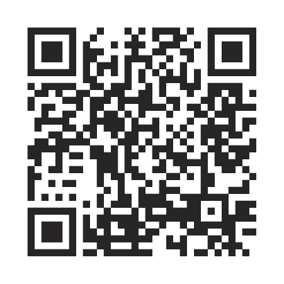
Order at missionsbooks.org

Slide 24
Thanks for attending.
MissionConnexion.global

